Slide 1

RESETTLEMENT AND REHABILITATION
PRESENTED BY: Mansheen Singh And Simmerpreet Kaur

Slide 2
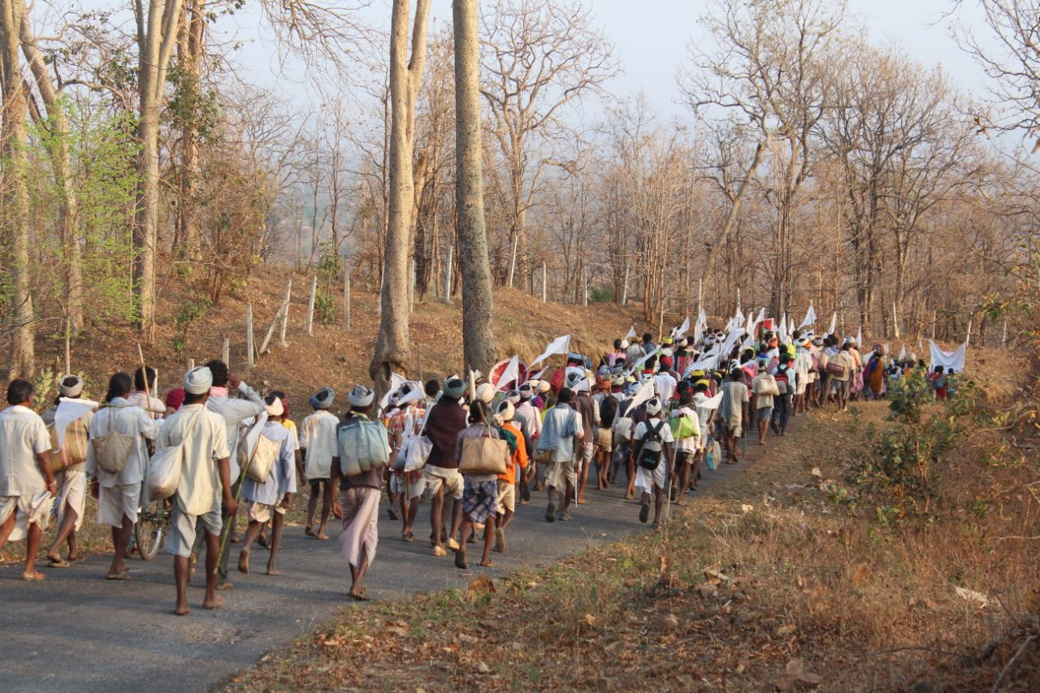
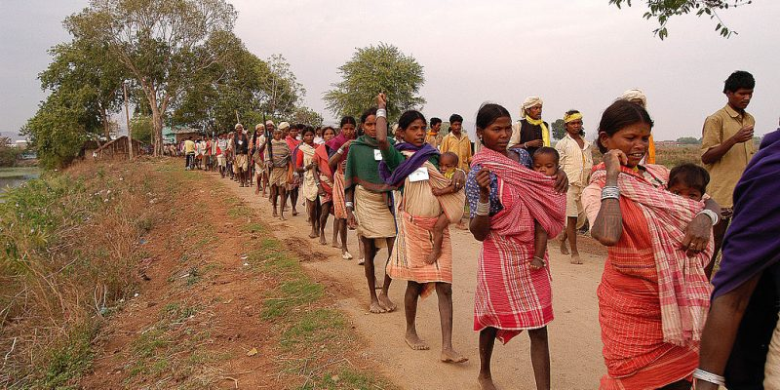
WHAT IS RESETTLEMENT ?
Resettlement is the process of moving people or communities from one place to another, often due to specific reasons such as urban development, infrastructure projects, environmental factors, or social and political changes.
Resettlement involves finding and providing alternative home and lands for the affected people

Slide 3
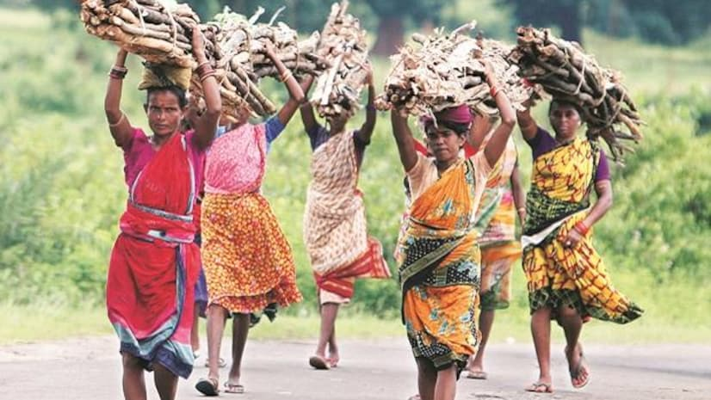
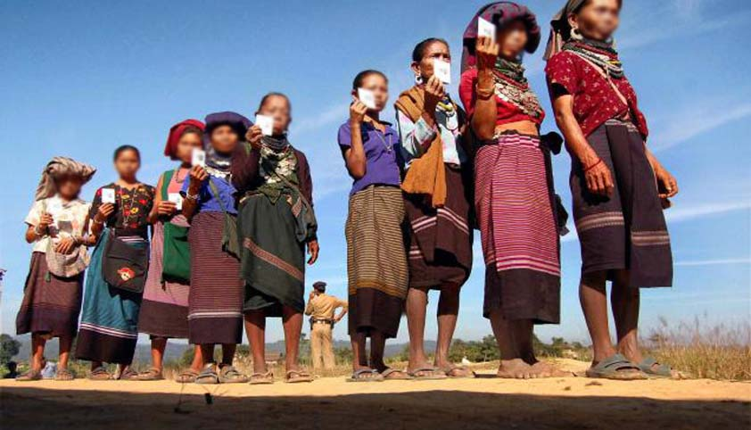
WHAT IS REHABILITATION ?
WHAT IS REHABILITATION?
Rehabilitation is a process of helping individuals recover and regain their physical, mental, or social well-being after experiencing injury, illness, addiction, or other challenging life circumstances.
The specific goals of rehabilitation is to restore the affected individual to their highest level of functioning and independence.

Slide 4
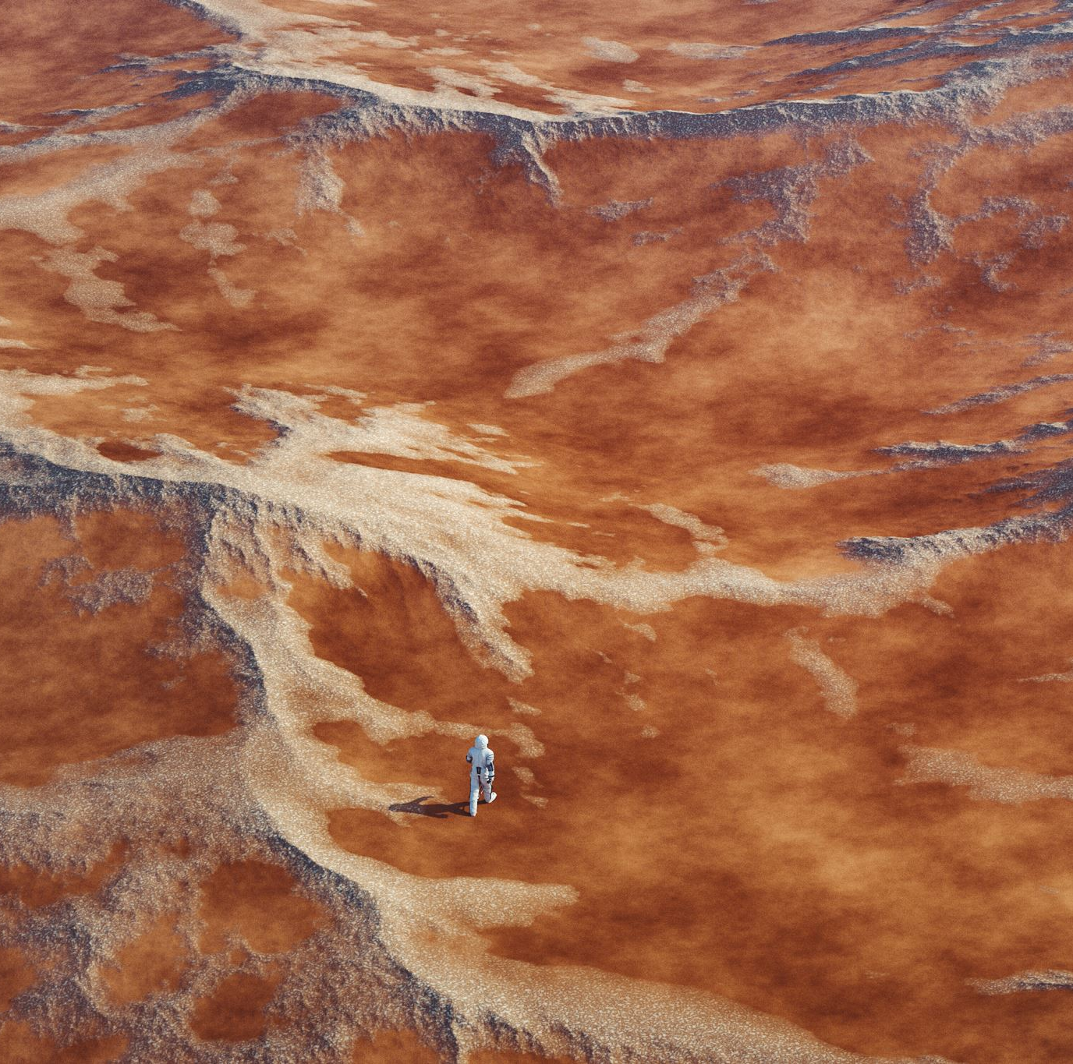
CAUSES OF DEVELOPMENT:
DISPLACEMENT DUE TO DAMS.
DISPACEMENT DUE TO MINING.
DISPLACEMENT DUE TO NATIONAL PARKS.

Slide 5
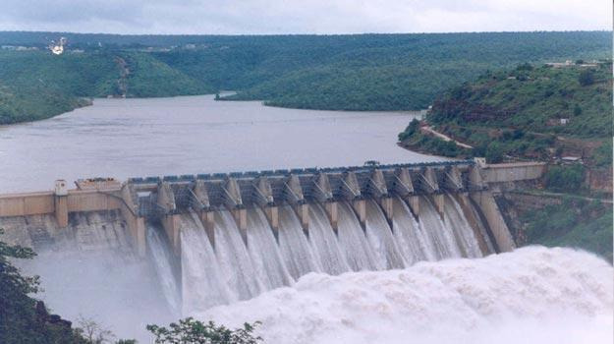
DISPLACEMENT DUE TO DAMS:

Slide 6
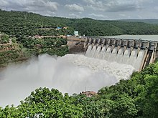
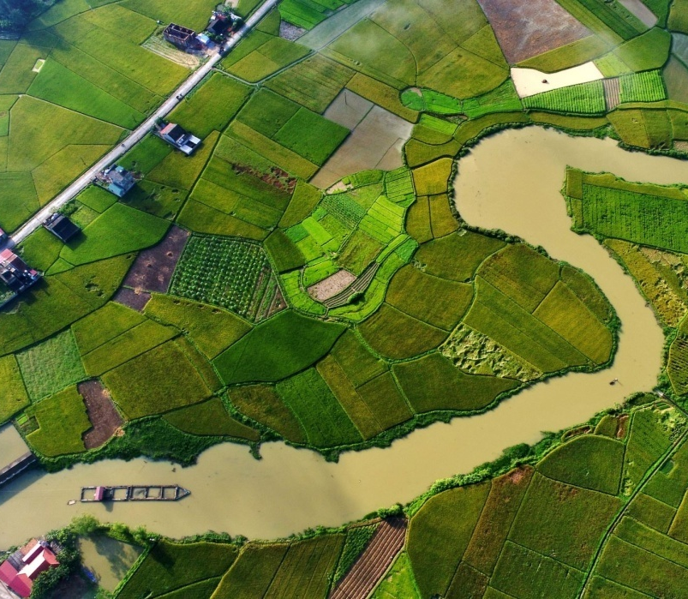
Large hydroelectrics dams are often built to generate electricity and manage water resources. The creation of reservoirs behind these dams can lead to the submergence of land, resulting in the displacement of communities living in those areas.
Millions of people were displaced during the big river valley projects like Hirakund Dam(Orissa), Bhakra Nangal Dam(Punjab), Srisailam Dam(Andhra Pradesh) and have made refugees in their own home lands.
Case of Tehri Dam(Uttaranchal) on the river Bhagirathi, would directly have an immediate impact on the 10,000 residents of Tehri town and the rehabilitation over here has become much more of a burning issue.

Slide 7
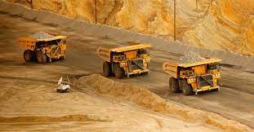
DISPLACEMENT DUE TO MINING

Slide 8
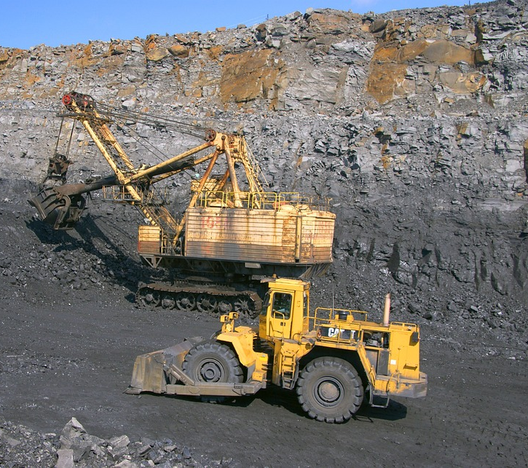
Mining operations, whether for minerals, coal, oil, or other resources, often require the acquisition of land. This can lead to the displacement of communities living in or near mining areas.
Mining displacement can disrupt the livelihoods of affected communities, particularly if they rely on farming, fishing, or other activities that are directly impacted by mining operations.
Mining activities can have adverse environmental and health effects, such as pollution of water sources, destruction of ecosystems, and exposure to hazardous substances. These impact can further affect the well-being of displaced communities.

Slide 9
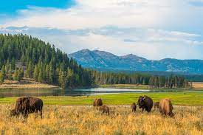
DISPLACEMENT DUE TO NATIONAL PARK

Slide 10
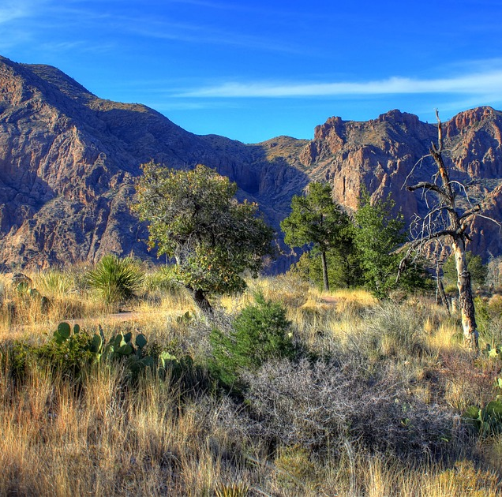
The establishment or expansion of national parks often involves the acquisition of land, which can lead to the displacement of communities living in or near these areas
Displacement can disrupt the livelihoods of affected communities, especially if they rely on farming, fishing, hunting, or other activities within the protected areas.
Displacement can result in the loss of cultural heritage, traditions and social cohesion within affected communities. Preserving these aspects can be an important consideration during the resettlement process.

Slide 11
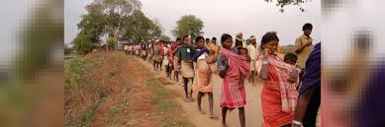
AFFECTED POPULATION:
People are forced to move out of their land due to both natural and manmade disasters.
Natural disasters like earthquakes, cyclones, tsunami etc. render thousands of people homeless and sometime even force them to move and resettle in other areas.
Similarly, developmental projects like construction of roads, dams, canals and flyovers displace people from their homes. Leakage of nuclear material in Japan resulted in millions of people being forced to leave the area for their safety.
Resettlement can influence the local economy, both positively and negatively, by affecting businesses and job markets.
Involuntary Resettlement refers to two distinct but related processes. Displacement is a process by which development projects cause people to lose land or other assets, or access to resources. This may result in physical dislocation, loss of income, or other adverse impacts.
The disruption of social and cultural networks is a common consequence of resettlement, which can lead to loss of identity and cohesion.

Slide 12
CHALLENGES IN RESETTLEMENT
Loss of land and property: Displaced individuals may lose their homes, farmlands, and livelihoods, leading to economic and social disruptions.
Psychological stress: Relocation can cause emotional stress and trauma, as people may be forced to leave behind familiar surroundings and face uncertainty about the future.
Access to services: Ensuring access to essential services such as healthcare, education, and clean water in the new location can be challenging , impacting the well -being of resettled populations

Slide 13
Cultural Adjustment: Adapting to a new culture, language, and customs can be difficult.
Housing and Shelter: Finding safe and suitable housing in the resettlement area can be challenging.
Economic stability: Establishing financial stability in a new environment can take time, especially if employment opportunities are limited.
Education: Ensuring access to quality education for children can be a concern

Slide 14

REHABILITATION MEASURES:
Education and Literacy Programs: Providing access to quality education, establishing schools in tribal areas, and implementing programs to improve literacy rates among tribal populations.
Healthcare Services: Ensuring access to healthcare facilities, mobile medical units, and awareness campaigns to address healthcare disparities and improve the overall health of tribal communities.
Cultural Preservation: Supporting initiatives that promote and preserve tribal languages, traditions, and cultural heritage.

Slide 15
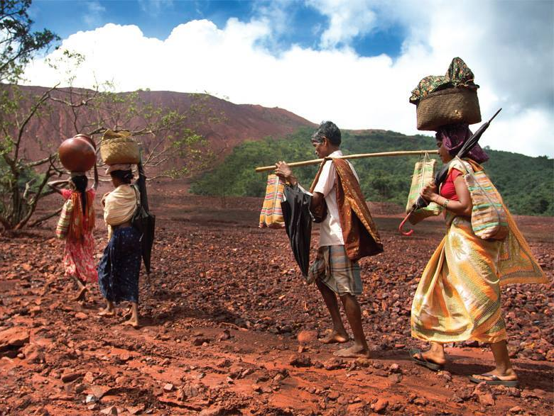
Livelihood and Skill Development : Offering vocational training and skill development programs to create sustainable employment opportunities for tribal youth and adults.
Land and resource rights: Securing land rights and protecting tribal lands from illegal encroachments, while also promoting sustainable land and resource management practices.
Tribal self-governance : Empowering tribal councils or self-governing bodies to make decisions on local issues and development projects.
This Photo by Unknown author is licensed under CC BY-NC-ND.

Slide 16
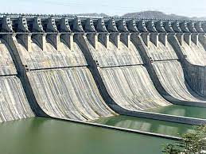
CASE STUDY " SARDAR SAROVER PROJECT
The Sardar Sarovar Project is located on the Narmada River in India, spanning the states of Gujrat, Madhya Pradesh, and Maharashtra.
The main goal of the project is to provide water for irrigation, drinking, and industrial use, as well as generate hydroelectric power.
A major controversy surrounding the project is the displacement of local tribal communities due to the dams construction.
There have been concerns about the ecological impact of the dam, including changes to river ecosystems and wildlife habitats.

Slide 17
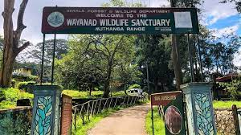
CASE STUDY "WAYAND WILDLIFE SANCTUARY
Wayand wildlife sanctuary is located in the Wayand district of Kerala, in the southern part of India.
Displaced 53,472 tribal families but till 2003, only 843 families could get the land.
Tribals felt betrayed and had started encroachment into the forest.
This led to violent encounters with the forest officials.

Slide 18


